Slide 1
The Passive
Grammar
Level: A2 – Grade 7/8
Goals: Can explain the difference between active and passive voice.
Can accurately use the passive voice in the present and simple past.

Slide 2
In the past letters were used to stay in touch. Nowadays social media is used instead.

Slide 3
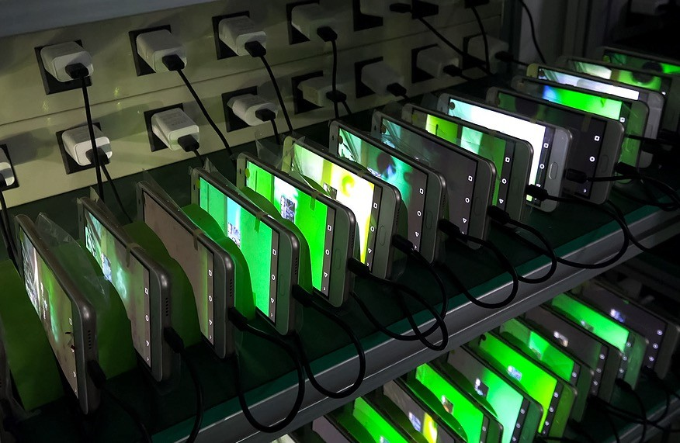
Preview and warm-up
The passive voice shifts the focus from the subject to the object of the sentence.
My smartphone was made in China.

Slide 4

Understanding the passive
Passive sentences focus on what happens to someone or something.
The passive voice is often used when the person doing the action is either
obvious or unimportant.
My laptop was designed in the USA. It was made in Asia.
It is connected to the internet. It is used for work.

Slide 5
Comparing the active and the passive
Active sentences always tell us who or what performs an action. Passive
sentences do not.
The object of the active sentence is the subject of the passive sentence.
Active present simple
Passive present simple
I update my laptop every week.
My laptop is updated every week.
People use e-mails for communication.
E-mails are used for communication
Workers make computers.
Computers are made.

Slide 6

Forming the passive in the present tense
The simple present form of the passive is formed from the present tense of the verb to be + the past participle.
The _{is} question |  | asked.
The _{are} questions |  | asked.

Slide 7
Reviewing the past participle
Remember: to form the passive you always need the verb to be + the past participle.
The past participle of regular verbs is formed by adding -ed.
  The past participle of many common verbs is irregular.
Infinitive Past participle
start started
buy bought
find found
take taken
drink drunk

Slide 8



















Give the past participle of these verbs
see
know
write
give
build
sell
invent
use
eat
make
speak
grow
play
produce
cook

Slide 9
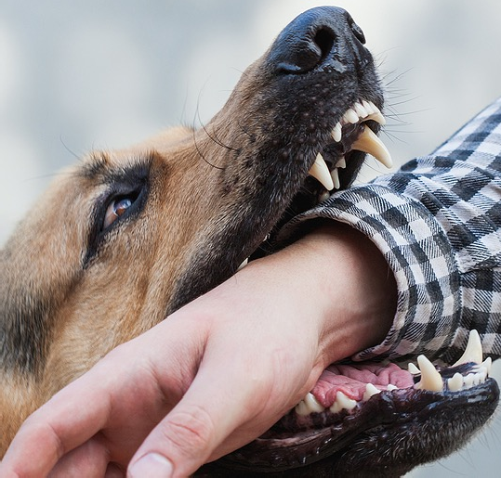
Describe the picture
Look at the picture below. Which of the sentences could you use to describe it? Discuss the differences between the options in terms of both meaning and emphasis.
The dog bites the
man.
The dog is bitten.
The man bites
The man is
the dog.
bitten.

Slide 10
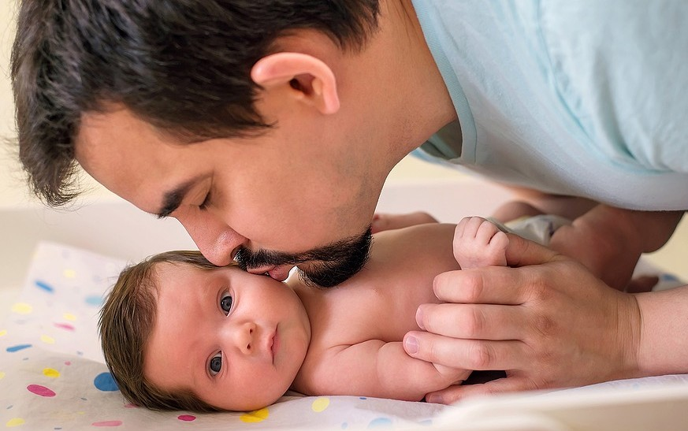
Describe the picture
Look at the picture below. What is happening? Can you think of more than one way to describe it?

Slide 11
Fill in the gaps
Fill in the gaps. Use the words in the column on the right.
made
Is are
developed published used
The internet used by billions of people around the world.
New technology is every day.
Many electronic products are in Asia.
Most Apps updated frequently.
Physical books and print media are still
.
E-readers are now also to read books digitally.

Slide 12






What is technology used for?
What is modern technology used for? Use the pictures below for inspiration or create your own examples.
…is used for…
(+ing)
….is used to…
(+infinitive)

Slide 13

Forming the past tense of the passive
The simple past of the passive is formed from the simple past of the verb to be
+ past participle.
The gift was |  | given.
The gifts were |  | given.

Slide 14




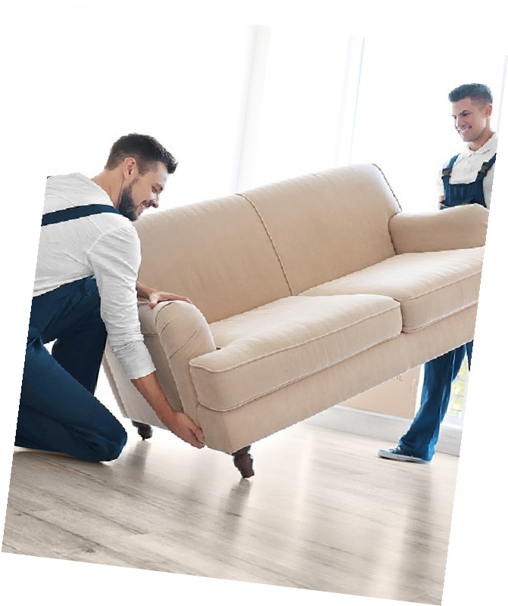


















Unscramble the words
new
yesterday.
was
sofa
The
delivered
B
in
hospital.
patient
treated
The
is

Slide 15
Stating the agent in the passive
Use by to introduce the agent in a passive sentence.
The agent can be a person or a thing.
  Remember that it is always grammatically possible to leave out the agent in a passive sentence, but not in an active sentence.
Active | Passive
J.K Rowling wrote Harry Potter. | Harry Potter was written by J.K Rowling.
Fire destroyed the building. | The building was destroyed by fire.

Slide 16
Active or passive voice?
ACTIVE PASSIVE
1. The man was arrested by the police.
2. The police arrested him at midnight.
3. These houses were built by the local government.
4. Euros are not accepted in every country.
5. I pay for some items on the internet in dollars.
6. The books were ordered yesterday.

Slide 17
Rewrite these sentences in the passive. Include the agent
1. Farmers in England grow wheat.
Wheat is grown in England.
2. People in England speak English.
3. People in England eat fish and chips.
4. Shakespeare wrote Hamlet.
5. An English man, Tim Berners-
Lee, invented the World Wide Web.

Slide 18
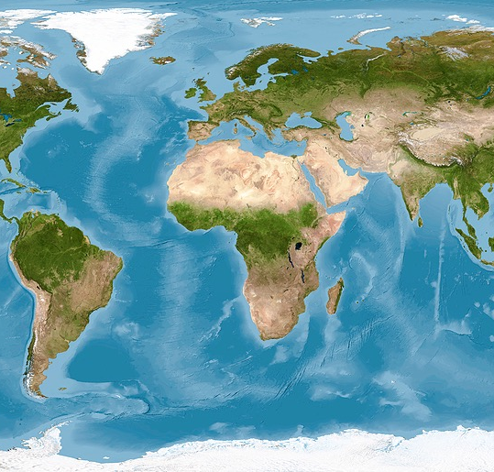
Where I live
Ask another student or the teacher questions about the country they live in. You can use the questions below for inspiration or create your own. Respond to their questions.
What famous
books were
What language is
written there?
spoken there?
What foods are
What technology
typically eaten?
was invented
there?

Slide 19
Homework

Slide 20







Homework writing activity
Select a country where English is spoken. Write a short text about the country. Use the key words below for inspiration. Try to include at least one sentence in the passive voice.
Food
Drink
Weather
Culture
Major cities
Technology

Slide 21

Find the verbs
Find the verbs in this lesson and write them down.
Which are new? Do you know all of them?
Look these words up.
Verbs

Slide 22
Very well done for completing the lesson☺
Where we covered the following:
Can explain the difference between active and passive voice.
Can accurately use the passive voice in the present and simple past.
Remember: Practice makes perfect!

