Slide 1
Checking - in
Vocabulary
Level A2 corresponds to basic users of the English language, i.e., those able to communicate in everyday situations with commonly-used expressions and elementary vocabulary.
Level: A2.2- Beginners – Juniors / Adults

Slide 2
Goals
Can describe the check-in process at a hotel and share my previous experience of staying at a hotel.
Can identify and list items that are found in a hotel room.

Slide 3
Welcome to the Palm Tree Hotel. You can check in at reception, and the porter will help take your baggage up to your room.
Enjoy your stay!

Slide 4
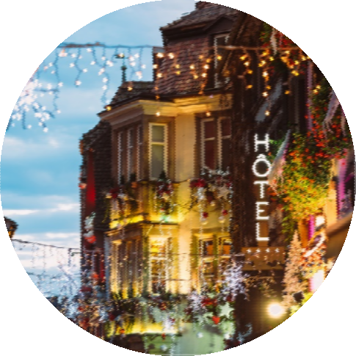
Vocabulary review
hotel
sightseeing
booking
tourist
baggage
city
room
Make a sentence with two words.
key

Slide 5
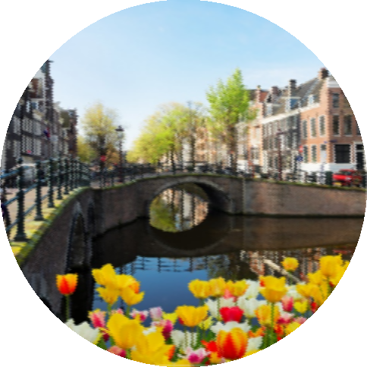
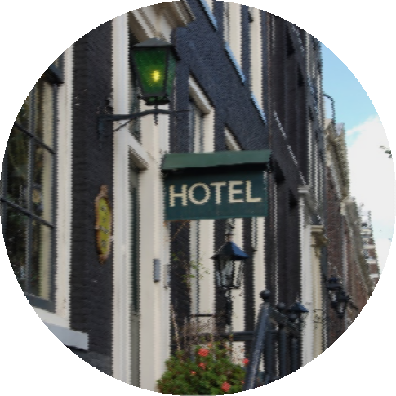
Going on a trip
I’m going on a short vacation to my favourite city – Amsterdam!
I’ve made a booking for three nights in a small hotel.

Slide 6
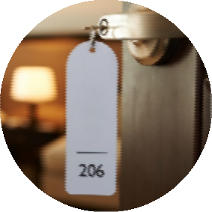
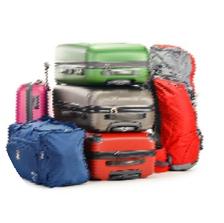


On vacation
Turn the key to open the door.
You can leave your baggage in the
room.
Every tourist has a selfie-stick these days!
I always go sightseeing on the first day
of a trip.

Slide 7
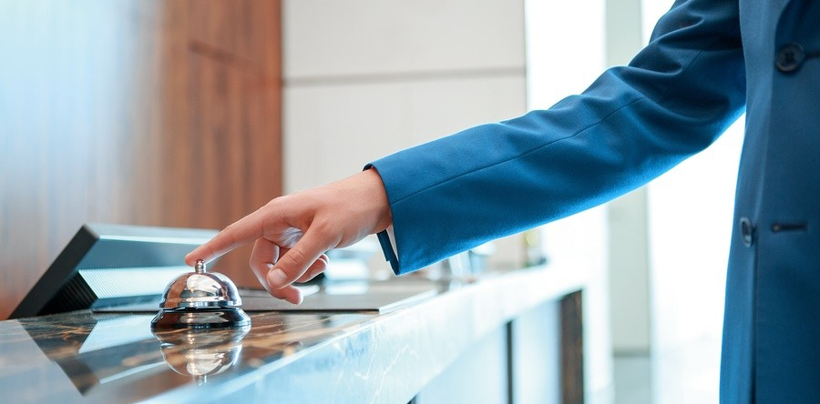
reception
Ring the bell at reception for service.

Slide 8
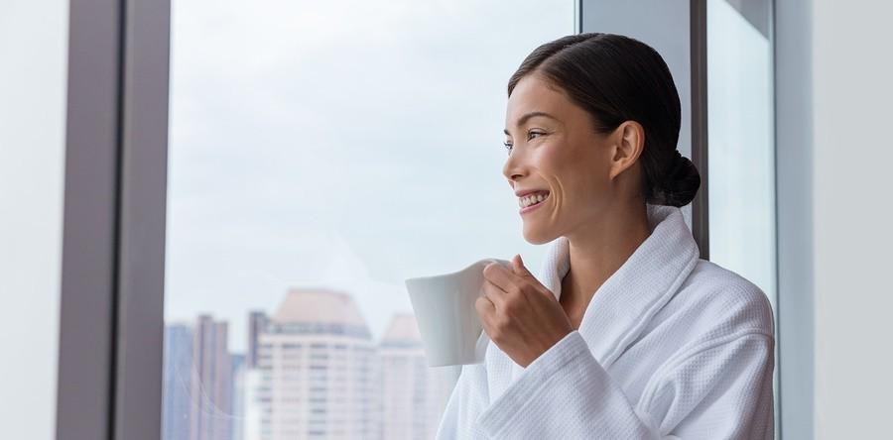
guest
It’s important to keep the guests happy.

Slide 9
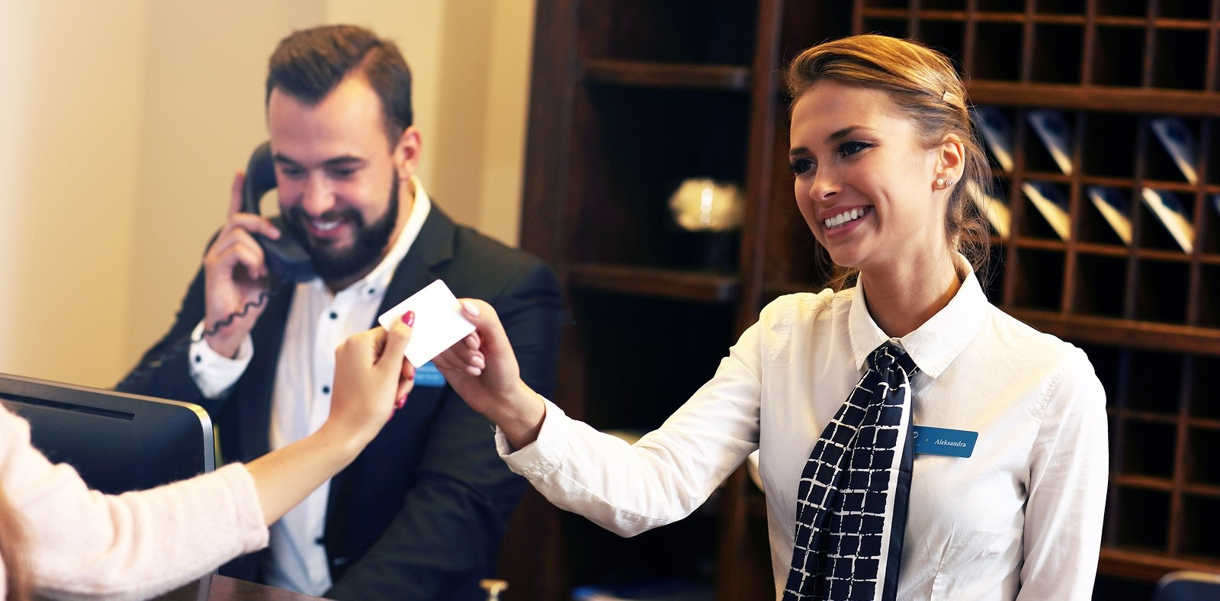
to check in
The receptionist will help you to check in.

Slide 10
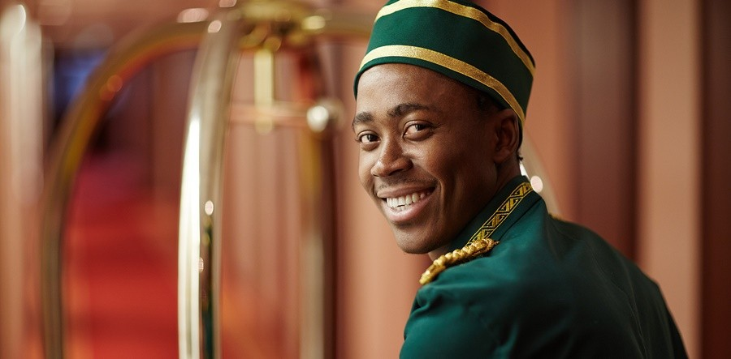
Porter
In America, they call them bellboys.
The porter will help you carry your baggage.

Slide 11
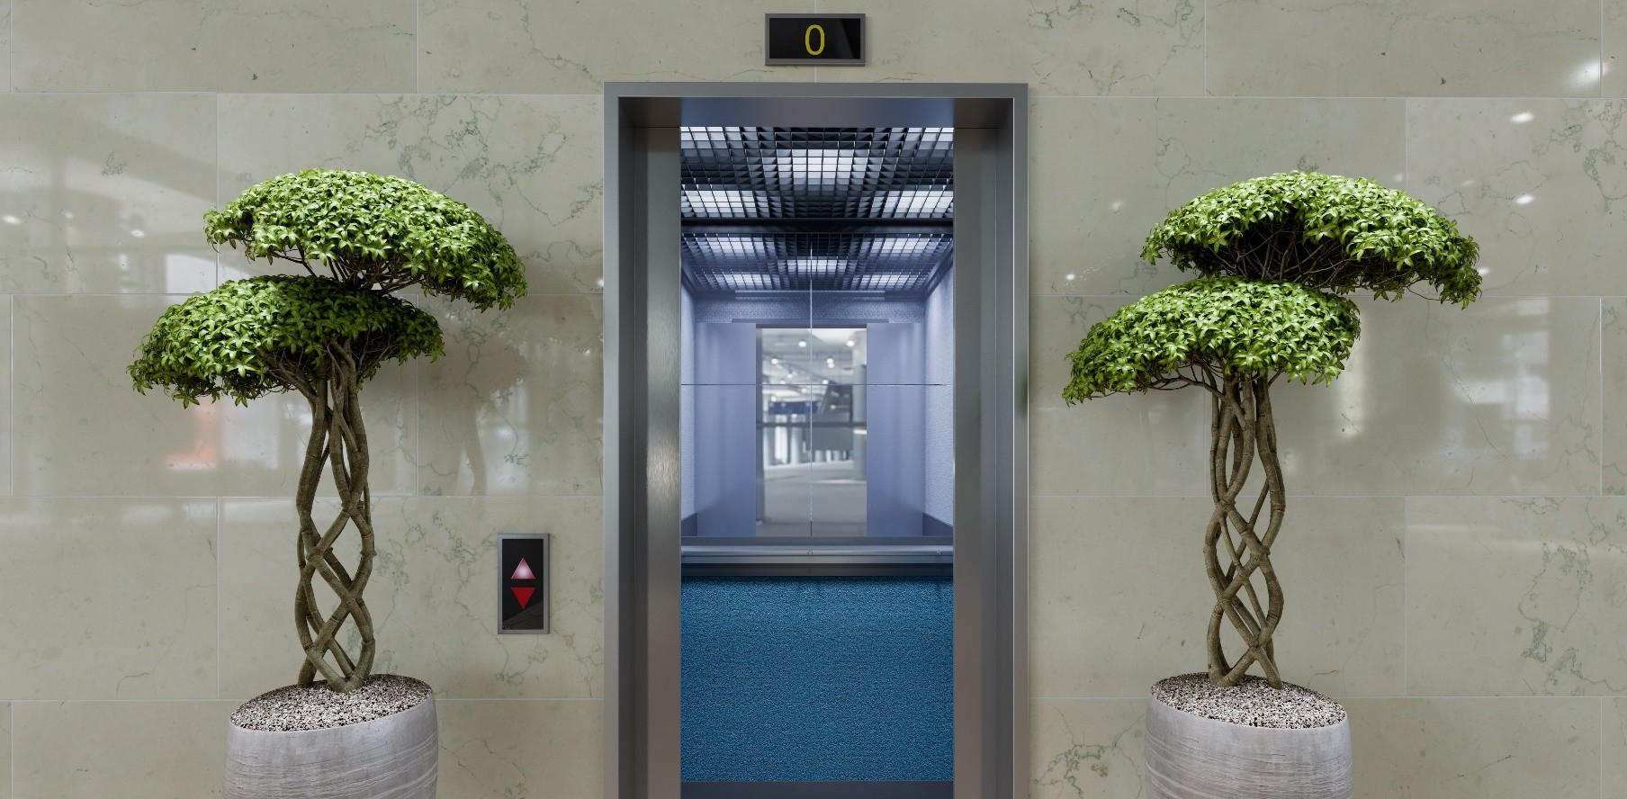
Lift or Elevator (both)
Your room is on a high floor, so it would be best to take the lift.

Slide 12
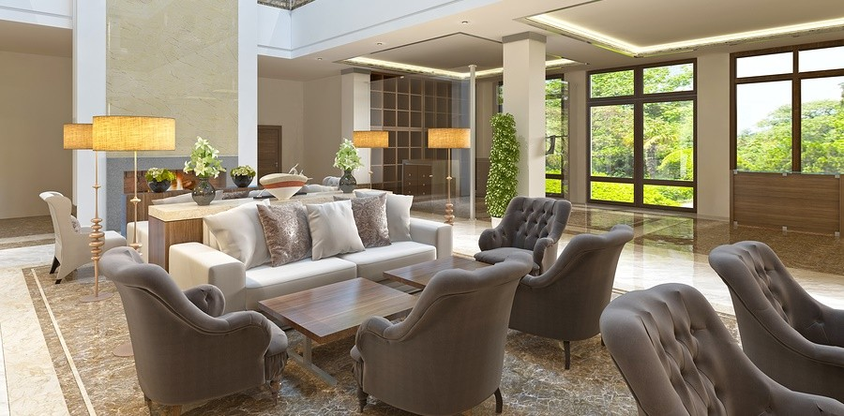
lounge
I’m sorry, your room isn’t ready. You can wait in the lounge.

Slide 13
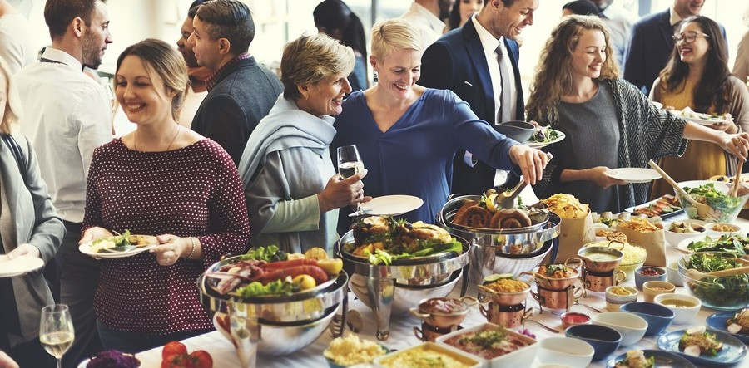
buffet
There is a buffet dinner in the restaurant from seven o’clock.

Slide 14
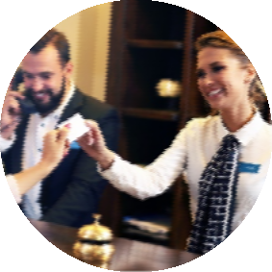
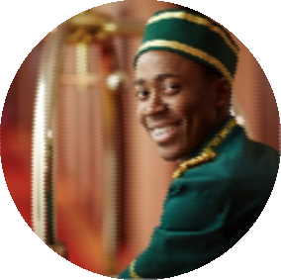

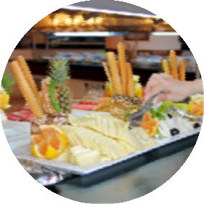
We hope you enjoy your stay
All guests should check in at reception on arrival.
The porter will take your luggage in the
lift.
You can relax in the lounge and read a newspaper.
Help yourself to the buffet breakfast
each morning.

Slide 15
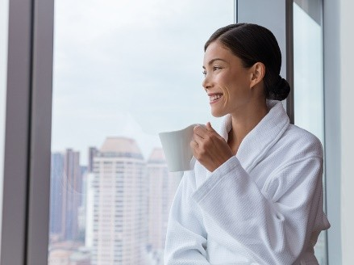
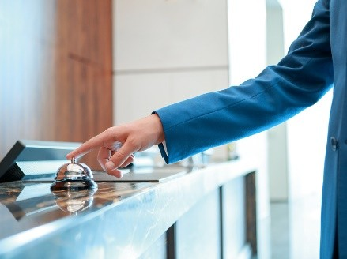
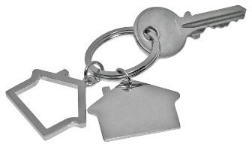
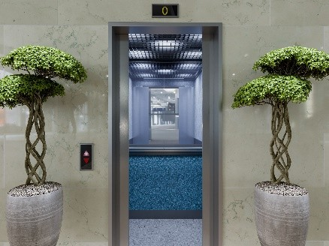
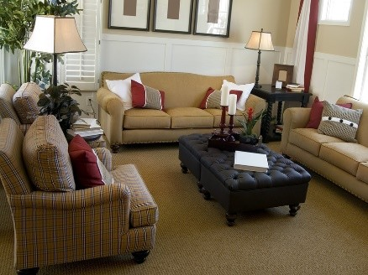
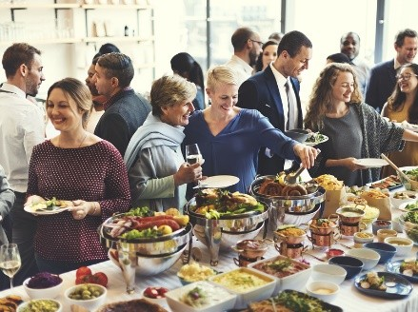
Match the words
1. | reception | 4. guest
2. | key | 5. buffet
3. | lounge | 6. lift
A |  | C | E
B |  | D | F

Slide 16
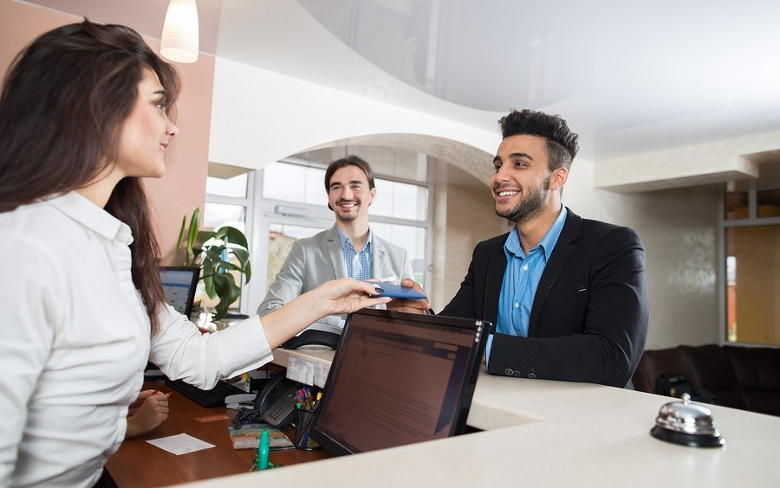
Checking in
16
Tell a classmate or your teacher about the last time you checked in to a hotel.
This is called a ?

Slide 17
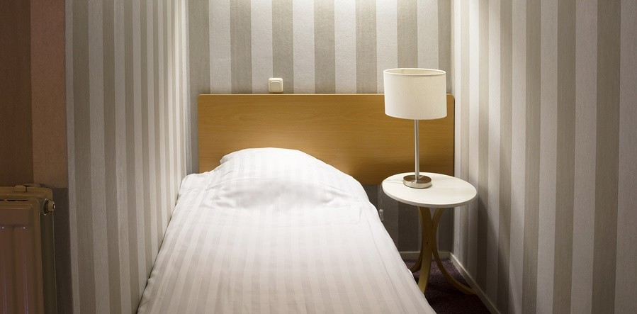
single bed
What is this called?
I don’t like to sleep in a single bed.

Slide 18
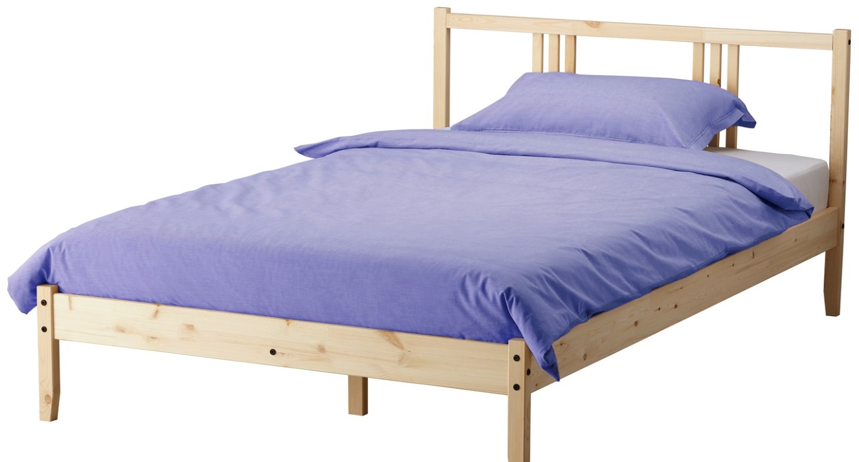
double bed
I have a double bed in my bedroom.

Slide 19
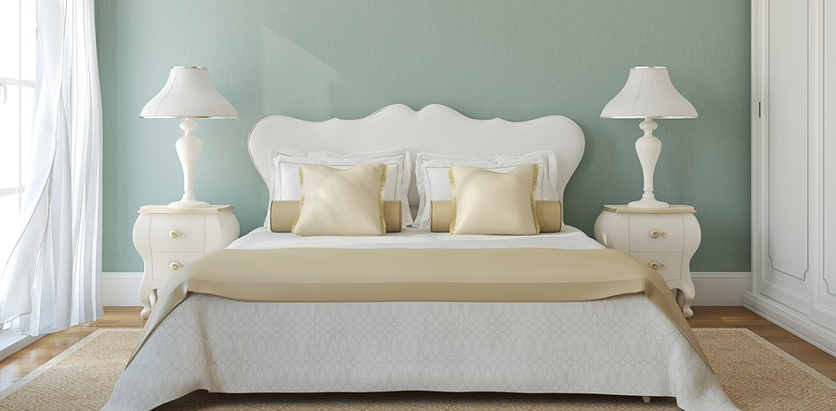
king size bed
Our hotel had a king size bed!
Also, name three things / items, you see in the picture.

Slide 20
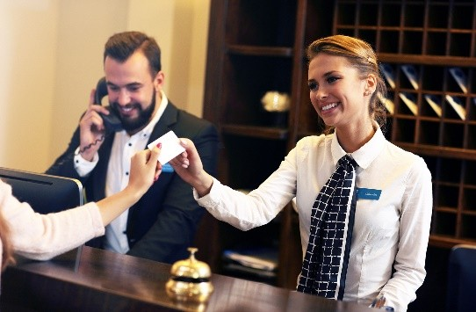
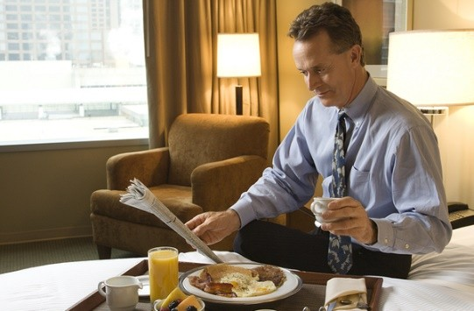

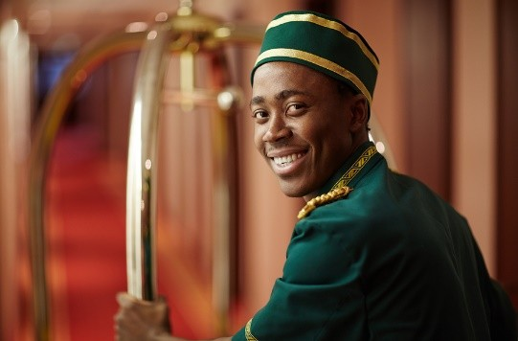
Put these pictures in order
a. check in
b. room service
c. flight d. porter
1. 2. 3. 4.

Slide 21
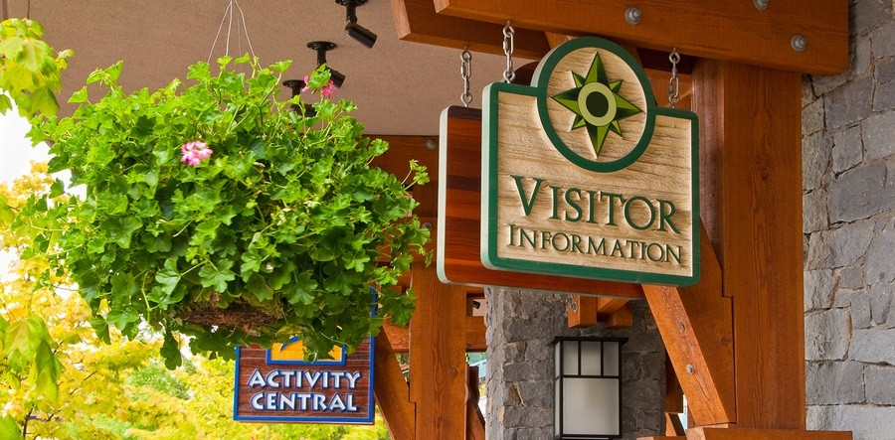
tourist information
You can get some local tips from the tourist information office.

Slide 22
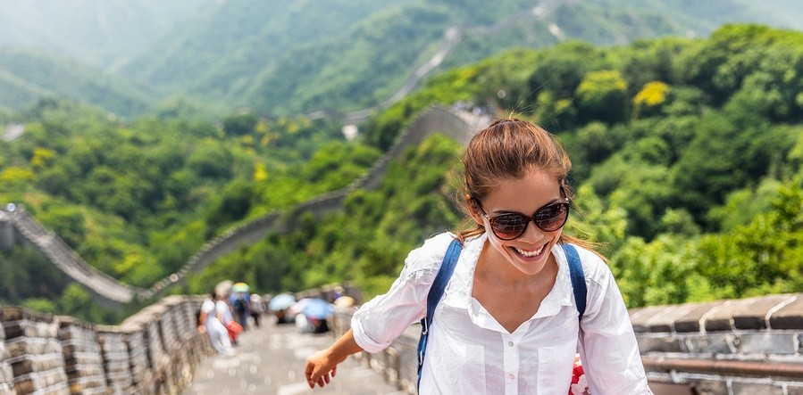
sights
Don’t forget to take in all the wonderful sights and places of interest.

Slide 23
Match the sentences
1. Ring the bell at…
will tell you about the top sights and attractions.
to your room.
2. The receptionist will…
3. The porter will…
c. reception for service.
4. Here is the key…
d. for your valuable things.
5. There’s a safe in the room…
e. help you to check in.
6. The tourist information desk…
f. top recommendations.
7. Consult the guide book for…
g. help you with your baggage.

Slide 24
Summarise our lesson
Can describe the check-in process at a hotel and share my previous experience of staying at a hotel.
Can identify and list items that are found in a hotel room.
Excellent!
Keep up the great work, you are moving forwards and upwards!

