Slide 1
Sentence structure – Eight parts of speech
Lesson One

Slide 2
Lesson Objectives:
Parts of a sentence
Word order
Subject + Verb
Subject + Verb + Object
Subject + Verb + Adjective
Subject + Verb + Adverb
Subject + Verb + Noun
Review

Slide 3
How to speak like a native☺
word |  | number of syllables
dog | dog | 1
green | green | 1
quite | quite | 1
quiet | qui-et | 2
orange | or-ange | 2
table | ta-ble | 2
expensive | ex-pen-sive | 3
interesting | in-tres-ting in-te-res-ting | 3 or 4
unrealistic | un-rea-lis-tic | 4
unexceptional | un-ex-cep-tio-nal | 5
Notice that every syllable
contains at least one vowel
(a, e, i, o or u) or vowel sound.
When we see a new word or a long word, that we find hard to pronounce, we should always use this method:
The Syllable vowel way: https://youtu.be/Vu6UVwkUgzc

Slide 4
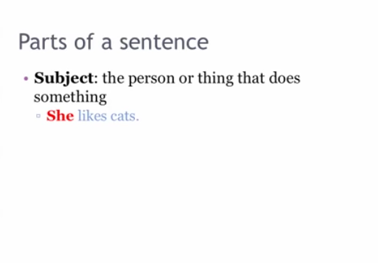

Slide 5
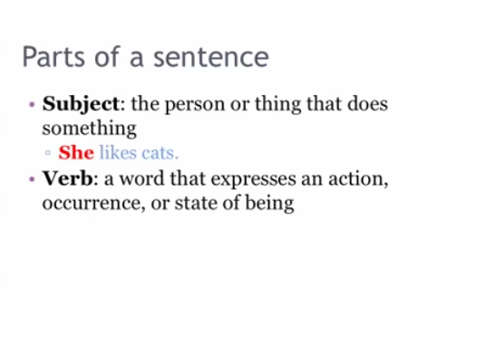

Slide 6
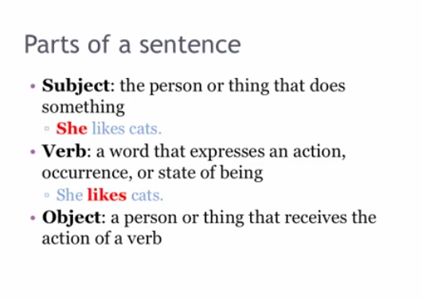

Slide 7
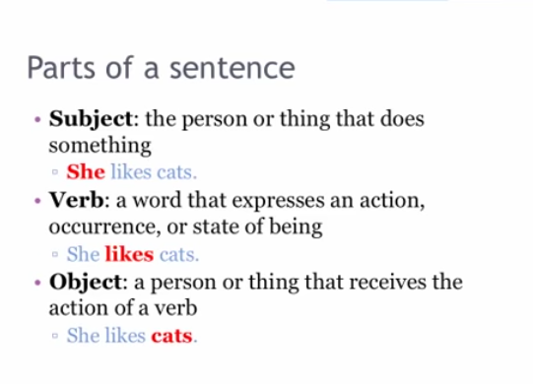

Slide 8
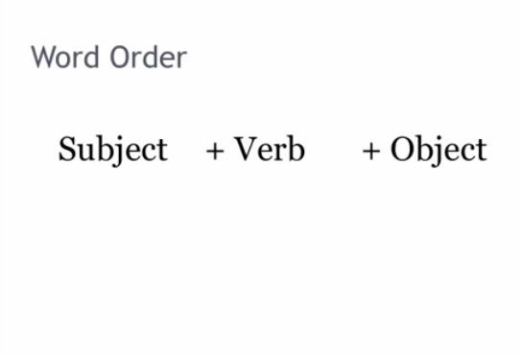

Slide 9
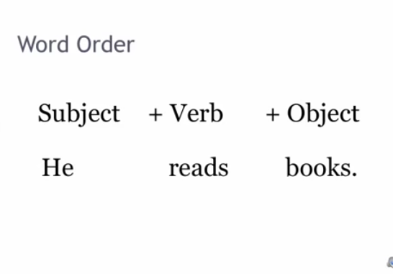

Slide 10
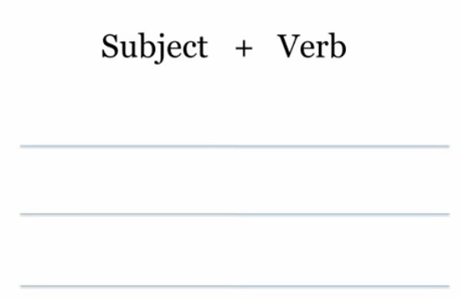

Slide 11
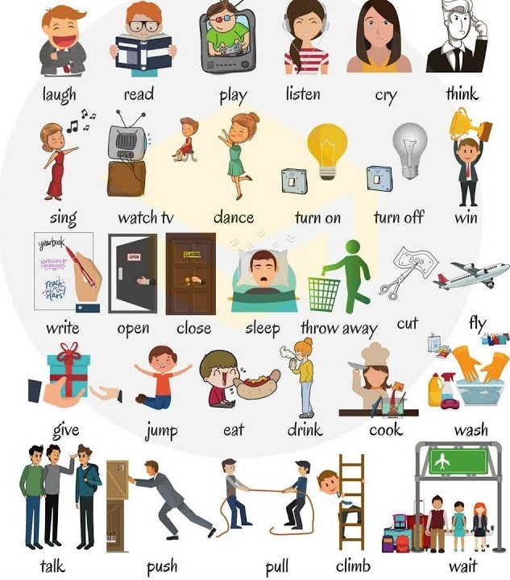

Slide 12
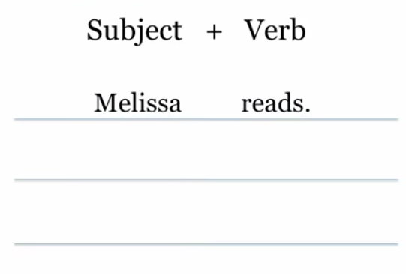

Slide 13
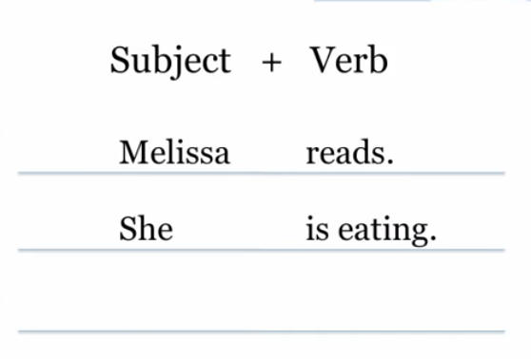

Slide 14
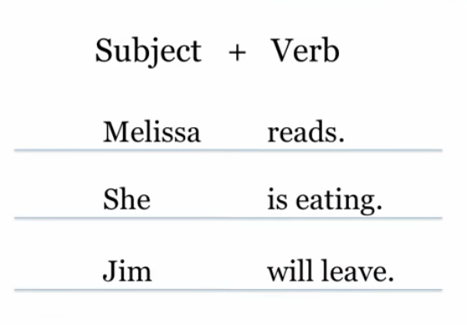

Slide 15
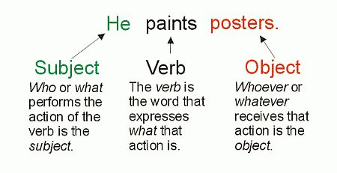

Slide 16
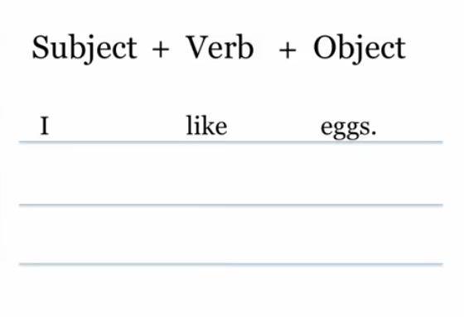

Slide 17
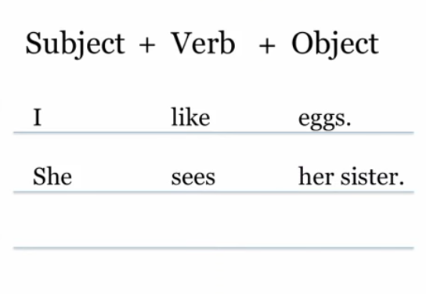

Slide 18
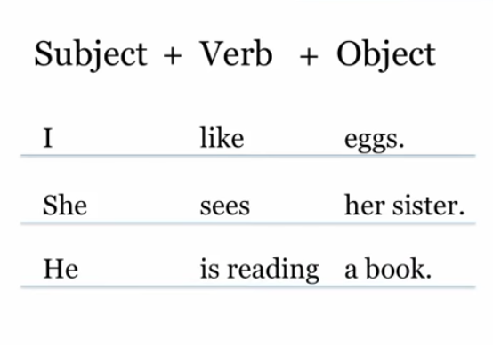

Slide 19
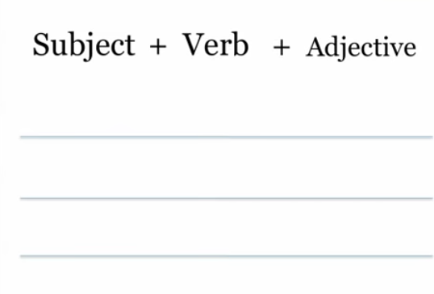

Slide 20
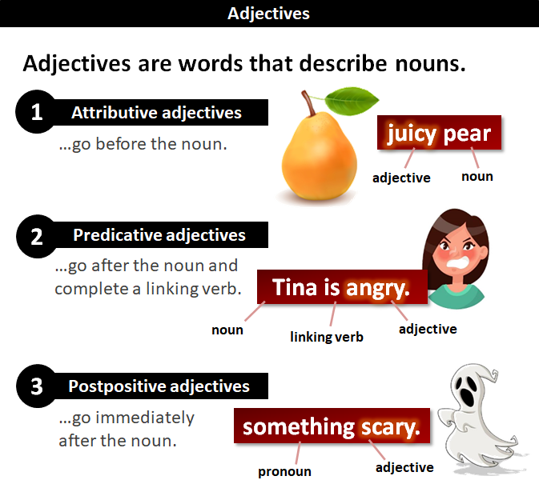

Slide 21
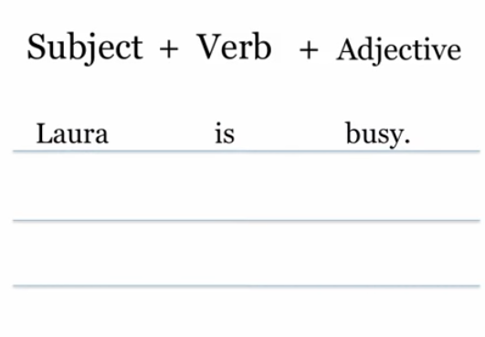

Slide 22
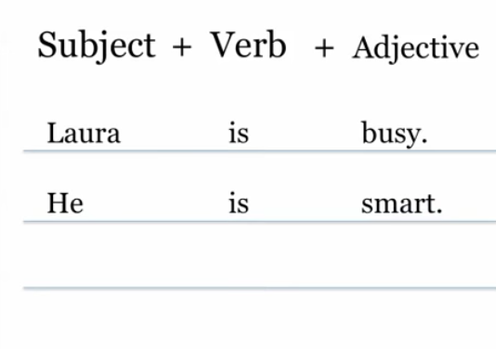

Slide 23
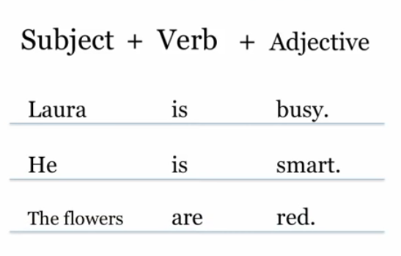

Slide 24
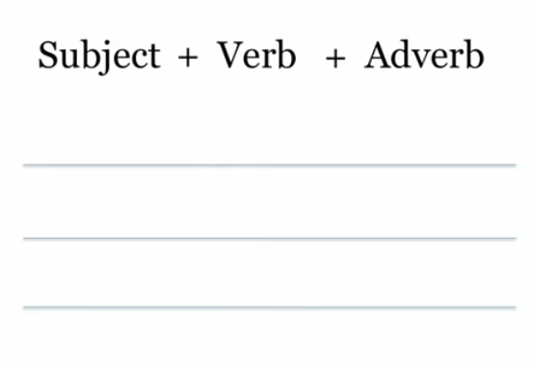

Slide 25
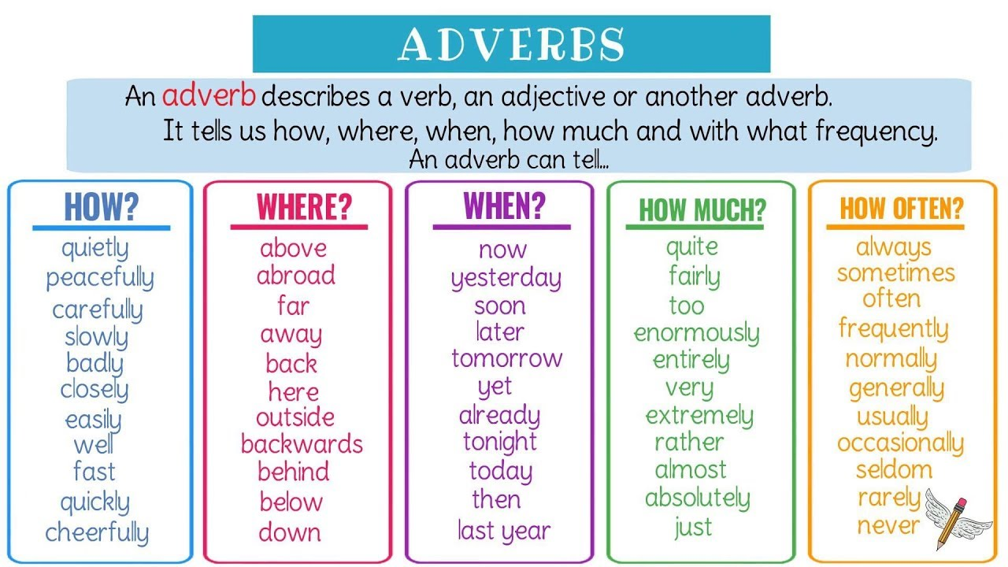

Slide 26
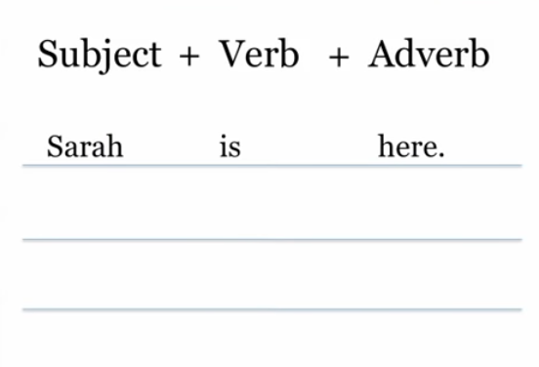

Slide 27
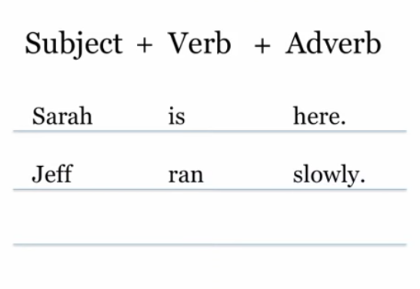

Slide 28
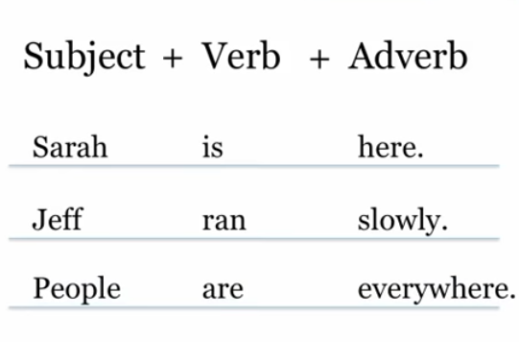

Slide 29
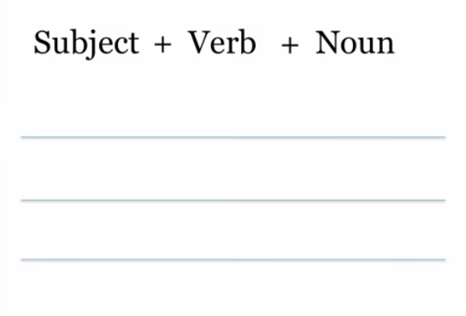

Slide 30
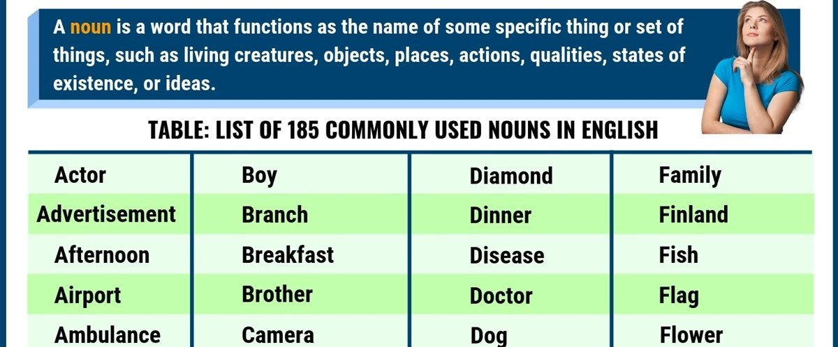
List of nouns

Slide 31
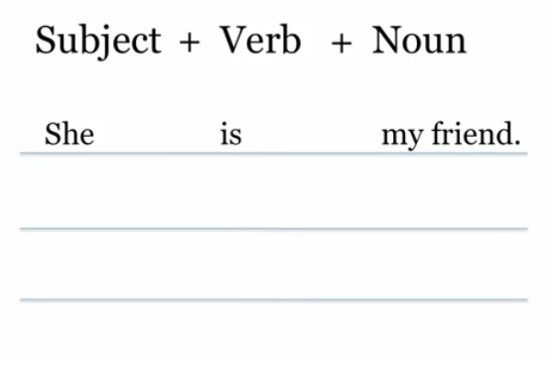

Slide 32
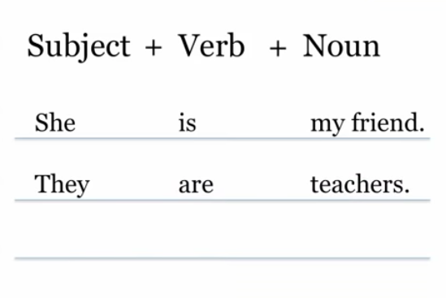

Slide 33
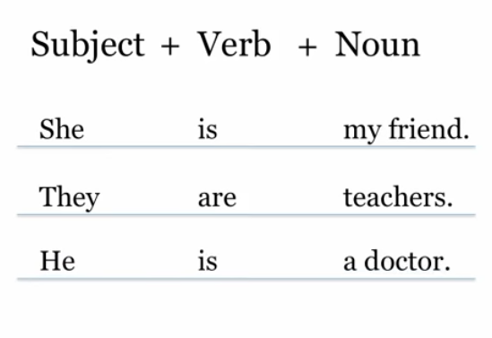

Slide 34
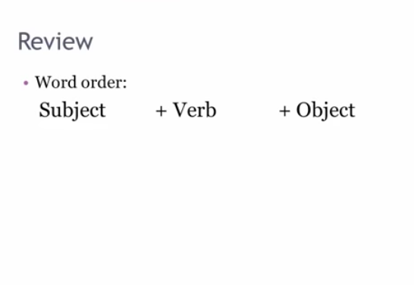

Slide 36
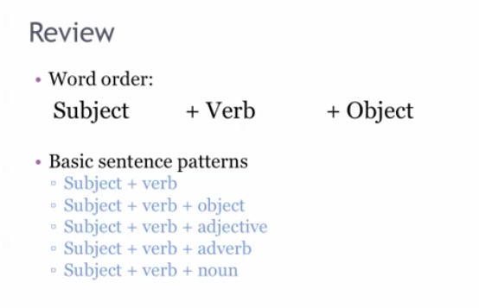

Slide 37
Quiz section☺
What is a verb?
Where do we use the verb in the sentence structure?
Does the adjective describe the noun / subject or verb?
Do we know what nouns are? People, places and?
What is the order of sentence structure?
Name 5 verbs?
Who can guess the other parts of the speech? Example: verbs, adverbs, nouns, adjectives - 4 missing. Have a guess.

Slide 38
Role play and game
Role play is where two students or more will stand up in class, and demonstrate what they have learned within the topic/subject of the lesson.
So the first student will start speaking/making a sentence in the order of the subject + verb + object.
The second student will reply with an answer or make another sentence using the subject + verb + object.
The correct student or students will remain standing and a new student will stand up and repeat the role play with them.
The roll play / game is over, when all the students have stood up.
The teacher can pick which student or students to stand up in any order.
Just so we can get the game going: A subject is a person, place or a thing. Example: Jenny is pretty!

Slide 39
Congratulations☺☺☺
You should all now know what a sentence structure is, in the English language, and we will cover more in the next lessons to broaden our sentence structure and our grammar.
Quote: “ Practice makes perfect! ”

