Slide 1
Using articles
Intermediate level
22 Slides
Grammar

Slide 2



Learning outcomes
I can provide a simple explanation of when articles should be used.
I can construct straightforward sentences using a/an/the and no article.

Slide 3

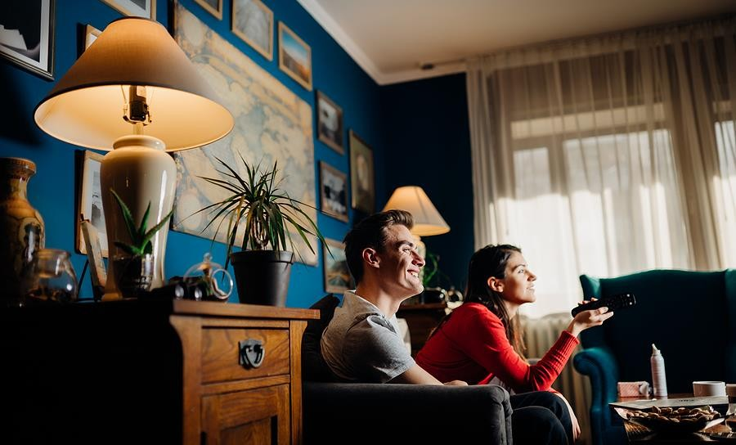
Warm-up
Who usually chooses what to watch in your house?
Do you ever have disagreements about what to watch?

Slide 4


Reading
Lily
Hey! What are you up to? Do you want to come over and watch a film?
David
Ugh, I knew it! The one about a lawyer who falls in love with a tattoo artist.
David Sure! Do you have a particular film in mind? NOT a romcom,
please! Romcoms are the
worst.
Lily
Yeah. It’s set in New York in the eighties. Come on! It’s the most popular film on Flixmax right now.
Lily
Well, I was thinking of the new film on Flixmax that everyone is talking about…
David
People will watch anything as long as there’s some action and a happy ending!
Why does Lily text David?
Do you know what the term romcom is short for? What is David’s opinion of romcoms?

Slide 5



Come on! It’s the most popular film on NETFLIX right now.
Real-life language
Look at the phrase highlighted in purple. Why does Lily say this to David? What does she want? Write the answer down

Slide 6
Articles: a/an or the?
Read these quotes from Lily and David’s conversation on slide 4. Answer the questions in the blue box.
Lily: Do you want to come over and watch a film?
David: Sure! But not a romcom, please!
Lily: What about the new film on Netflix that everyone’s talking about.
We use the indefinite article
( ) when we are talking about an unspecific person or thing.
We use the definite article
( ) when we are talking about a specific person or thing.
In the first two sentences, are Lily and David referring to a specific film?
What film is Lily referring to in the third
sentence?

Slide 7





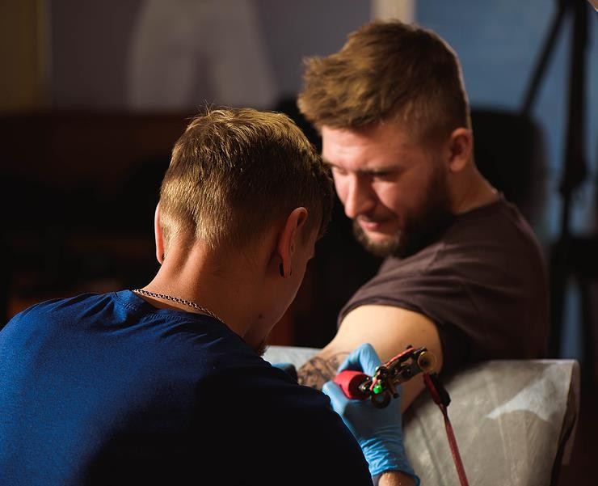
Further uses of the indefinite and definite article.
Read these quotes from the conversation on slide 4. Answer the questions in the blue box.
Ugh, I knew it! The one about a lawyer who
falls in love with a tattoo artist…
Come on! It’s the most popular film on Netflix
right now.
We use the indefinite article before jobs. Can you identify two examples of this in the sentences above?
We use the definite article for superlatives. Can you find an example of this in the sentences above?

Slide 8
Fill in the gaps
Complete the sentences with a/an or the.
I wanted new sweater for Christmas but one I got isn’t very
nice.
1
barber shop on my street is closed because the barber is on holiday. Is there
barber near you I could go to instead?
2
My cousin is working as teacher now and he loves it! He says it’s
best job ever.
3
I need tool to remove this plug from the kitchen wall. Where’s
one with the red handle?
4
She wanted diamond ring, but ring he bought her had a ruby.
5

Slide 9
No article
Read these quotes from the text and answer the questions in the blue box.
Not a romcom, please! Romcoms are the worst.
People will watch anything as long as there’s some action and a happy
ending.
It’s set in New York in the eighties.
We use no article to refer to people or things in general. Can you find two examples in the sentences above?
We use no article before most place names. Can you find an example in the sentences above?

Slide 10
Place names: definite article or no article?
Read the example sentences below and answer the question in the blue box.
They visited the United States last April.
Have you ever been to the Himalayas?
The Nile is the longest river in the world.
In some cases, however, we use the definite article. This can be for some countries and groups of islands, as well as some mountain ranges and rivers
Can you think of any other place names that use the definite article?
As you saw in the previous slide, we use no article before most place names. This includes most countries, cities, and the continents. Here are some examples:
Australia, China, Dublin, Europe, South
America
Can you think of some other place names that use no article?

Slide 11
Match
Match the sentences with the rules for using a/an, the or no article.
I’m looking for a new laptop, mine is too old.
no article is used to talk about things in general.
1
a
Pets are great friends and very good for
mental health.
an is used before a job (that starts with a
vowel sound).
2
b
I lived in Canada for two years.
a is used to mention an unspecific person or thing (ie. we don’t know which one).
3
c
I’d like to be an accountant, as it is a well-paid job.
the is used for a specific person or thing.
4
d
You wanted a new watch, but the one
you got looks old.
no article is used before most place names.
5
e

Slide 12

Discuss
Read the statement below and answer the questions in the red boxes.
I hate romcoms. They’re so boring. I prefer action movies or thrillers any day!
Do you agree with this person? Give a reason for your answer.
Can you think of any specific examples of the types of movies mentioned above?
What was the last romcom, action movie or thriller that you saw?
Did you enjoy it?

Slide 13
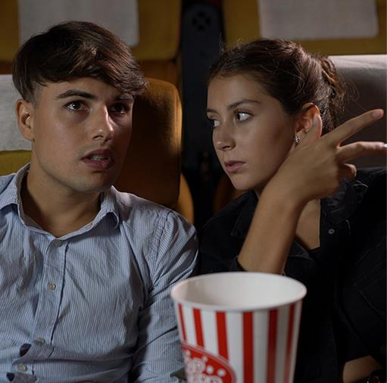
Mystery film
Choose a film you really like. Describe it to your classmates without saying its name. Keep going until your classmates guess the film. Be careful with the use of articles!
I am thinking about a (horror) film.
The film is about… and there are… main characters…
The characters are…
I like the film because…

Slide 14

Let’s reflect!
Can you provide a simple explanation of when articles should be used?
Can you construct straightforward sentences using a/an/the and no article?

Slide 15

Choose the correct option 15
Additional practice
1
We stayed in extraordinary hotel in Miami.
a. a b. an c. the
d. (-) no article
2 John bought a new car last week. Unfortunately, car broke down after a week.
a b. an c. the d. (-) no article
3 Yesterday’s test was hardest test ever!
a b. an c. the
d. (-) no article
4 vegetarians do not eat meat.
a b. an
c. the
d. (-) no article

Slide 16

Complete the sentences
Fill in the gaps using the options in the boxes below.
Additional practice
We finally found apartment, but we don't have keys yet.
a an the
(-) no article
1
pet shop has pretty good selection of
collars.
2
Semi works for Arabian company which specialises in space communications.
3
4
When I was in China, I stayed in hotel with walls made of gold.
We only had bread and butter for dinner last night.
5

Slide 17


Talk about a bad TV series 19
Talk about a TV series you would not recommend. Use the ideas in the box to help you. Remember the correct use of articles.
Additional practice
type of TV series
actors and characters
plot
reasons why you didn’t like it

Slide 18

Yesterday was… 20
Talk about what you did yesterday. Pay attention to how you use articles!
Additional practice
What did you do yesterday?
Well, yesterday was a day.
I…
Type of day
What you did
Who you saw
How you felt

Slide 19
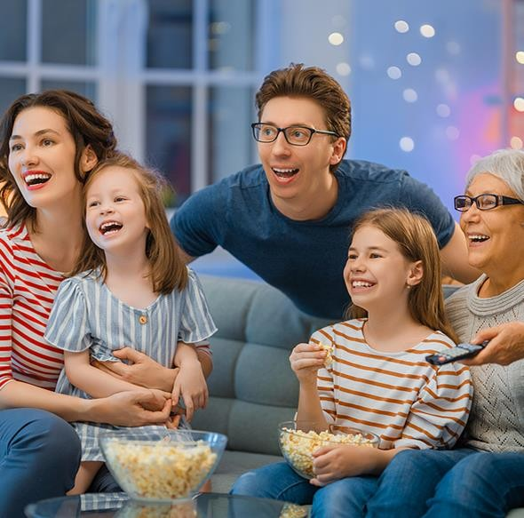
Discuss
Which of these factors are important to you when you choose a film?
Pick one from below and explain why. Are there any other important factors that aren’t
mentioned here?
Additional practice
the director
the length of the film
the type of film
reviews and recommendations

Slide 20


Discuss
Additional practice
What’s the last thing
you watched?
Would you recommend it to everyone or only to people with a specific taste? Explain.

Slide 21
Summary
Articles:
We use a/an to for unspecific people or things, as well as before jobs.
We use the for specific people or things, superlatives, and for some place names.
No article:
to speak generally about things or people
before most place names

